Slide 1
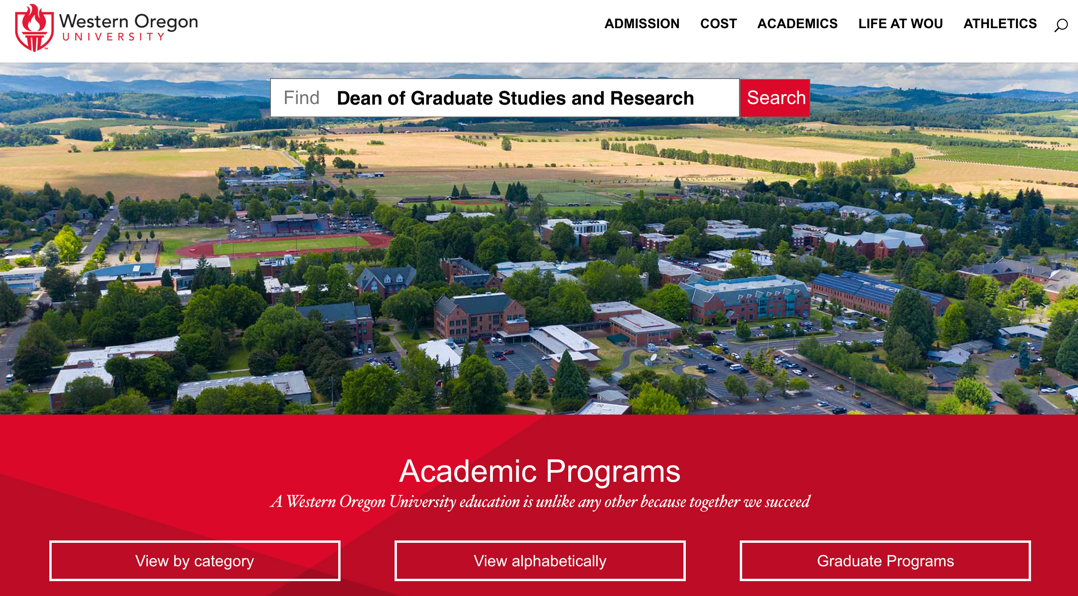

Slide 2
Today’s Discussion: Graduate Studies and Research
How will this new unit meet the challenges of a 21st century learning environment, while also helping the university fulfill its mission and adhere to its strategic plan?

Slide 3
WOU creates lasting opportunities for student success through transformative education and personalized support.
Student Success
Academic Excellence
Community Engagement
Accountability
Sustainability and Stewardship
Strategic Planning Scorecard

Slide 4
Challenges

Slide 5
”Is College Worth it Anymore?”

Slide 6
Supply and Demand
Undergraduate student “supply” is decreasing
Less graduating high school students
Less international students
Competition for those students is increasing
Oregon Community Colleges beginning to offer BAS programs

Slide 7
Where does the money come from?
Public institutions are slowly turning into private institutions
State funding typically decreasing

Slide 8
Where there is a will, there is a way
Forward Together

Slide 9
Graduate Studies and Research
Graduate Studies
Sponsored
Projects
TRI Centers
Center of Evaluation, Technology and Research
Center on Early Learning & Youth Development
Center on Student & Community Services

Slide 10
Graduate Studies
TRI
Sponsored Projects
Transformation, Collaboration, and Innovation

Slide 11
Where there is a will, there is a way
Graduate Studies

Slide 12
Good news!
Graduate student enrollment is increasing nationwide (Council of Graduate Schools)

Slide 13
Even better news!
WOU Graduate Studies is poised to increase enrollment, quality of programs, types of programs and ways to deliver them.

Slide 14
Enrollment Management Goal: Obtain 600 graduate student headcount by fall 2024
Market programs with potential for high growth
Develop new programs
Increase Accessibility
Assess cost and feasibility
Recruitment
WOU: Salem

Slide 15
Graduate Studies Three Pillars of Operating Framework
Content Core Knowledge
Applied Skills
Dispositions and Values

Slide 16
Graduate Studies Professional Learning Community > Goals
Mission Statement
Hooding Ceremony
Student Orientations
Seminars of shared experiences

Slide 17
Graduate Studies
TRI
Sponsored Projects
Transformation, Collaboration, and Innovation

Slide 18
Where there is a will, there is a way
Sponsored Projects

Slide 19
Sponsored Projects
Attracts the best faculty and students
Trains future teachers and scientists
Builds infrastructure and resources
Service to society
Stay on the cutting edge
Faculty fund projects of interest

Slide 20
Transformation, Collaboration, and Innovation
Assessment of current office services and historical funding
Create/solidify new mission and objective
Professional development for faculty and staff (and students)
Recognition
Bring people together – create a culture of grant writing.
And…

Slide 21
Where there is a will, there is a way
The Research Institute

Slide 22
Transformation, Collaboration, and Innovation
Assessment of each Center
Management by Walking Around
Create/solidify new mission and objectives
Advocate for additional resources
And…

Slide 23
Question:
Where are you on the Strategic Planning Scorecard and where do you want to be?
How can Graduate Studies and Research get there?

Slide 24
Where there is a will, there is a way
Forward Together

Slide 25
Dr. Natalie A. Lupton
Professor, Information Technology and Administrative Management
Program Coordinator, MS-ITAM
Central Washington University

